Slide 1
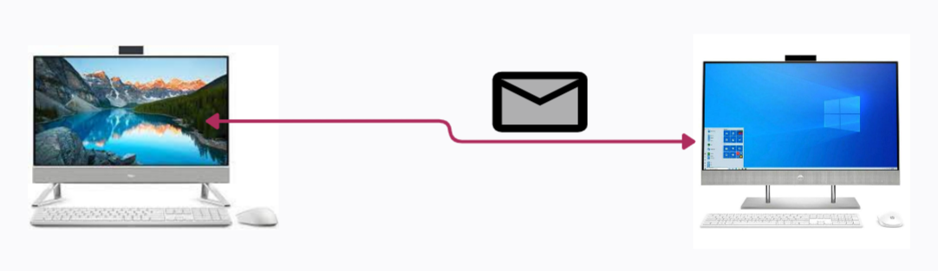
HTTP Status Codes
Imagine you're sending a letter through the mail. Now, let's say you receive a response back that's not just a letter, but also a small note indicating how things went with your letter. Did it reach its destination? Was there a problem? This little note helps you understand what happened with your letter.
Did it reach its destination?
Was there a problem?

Slide 2
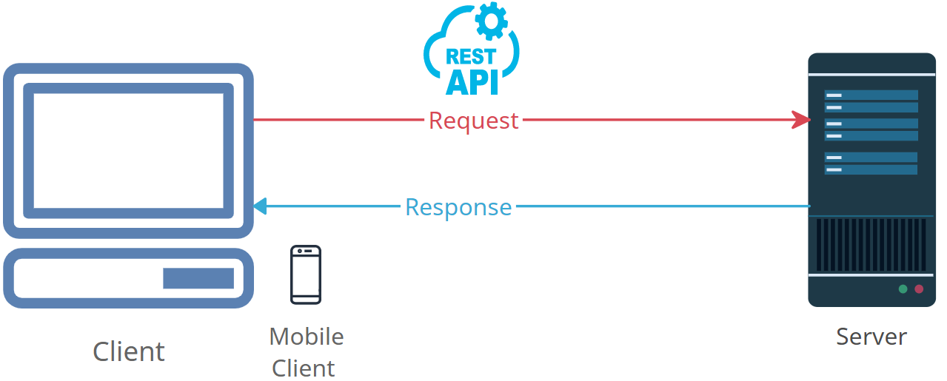
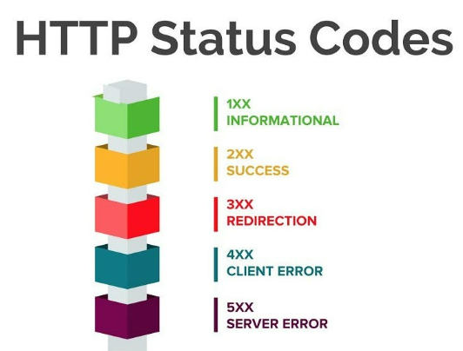
HTTP Status Codes
In the world of the internet, when you request a web page (like clicking on a link or typing a website's address), your web browser sends a request to a server somewhere else. The server processes your request and sends back a response to your browser. Just like the note in the mail, this response includes a code called an "HTTP Status Code."

Slide 3
HTTP Status Codes
HTTP Status Codes are like quick messages that tell your web browser how things went with your request. They're a way for the server to communicate with your browser without writing out a full explanation.

Slide 4
HTTP Status Codes
200 OK: This is like getting a thumbs-up. It means your request went well, and the server is sending you the web page you asked for.
404 Not Found: This is like getting a "Sorry, I couldn't find what you're looking for" note. It means the server couldn't find the web page you asked for.
500 Internal Server Error: This is like getting an "Oops, something went wrong on our end" note. It means there was a problem with the server, not your request.
So, think of HTTP Status Codes as those little messages that help your web browser to understand what's happening when you're browsing the internet.

